Slide 1
One Nation Senate Battleground Study II
May 13-18, 2017
N=1,205 2018 Likely Voters
States: AZ, FL, IN, LA, MO, MT, ND, NV, OH,
PA and WV

Slide 2
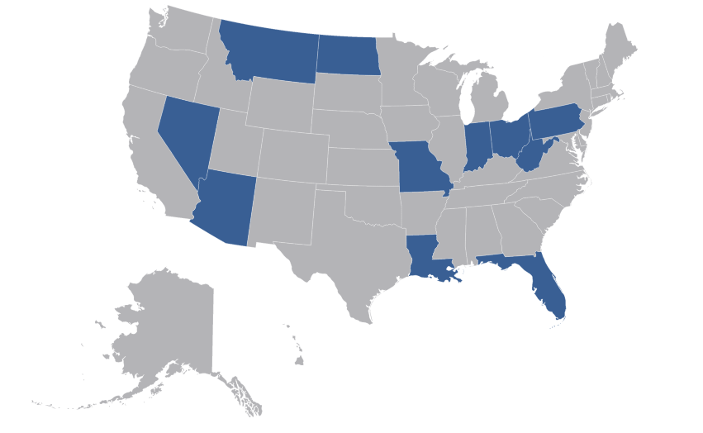
Methodology
N=1,205 likely 2018 voters
Margin of Error ±2.8
57% of interviews conducted via cell phone
Fielded May 13-18, 2017
Distributed proportionate to the voting populations in each state
Battleground / Key states: AZ, FL, IN, LA, MO, MT, ND, NV, OH, PA, WV

Slide 3
Right Direction / Wrong Track
Overall, do you think things in the country are headed in the right direction or are things off on the wrong track?
Most Likely To Say Right Direction
Trump voters (75%)
Conservatives (66%)
Liberals (86%)
Clinton voters (89%)
Most Likely To Say Wrong Track
Republicans (74%)
Fathers (53%)
Men / No college degree (53%)
Democrats (85%)
African Americans (81%)
Missouri (67%)
Moderates (65%)
“Other” 2016 voters (64%)
Women / College degree (64%)
42% Right Direction
51% Wrong Track

Slide 4
Generic Ballot
I know it’s a long way off, but thinking ahead to next year’s elections, if the election for the U.S. Senate were being held today, would you vote for…
Vote Republican
Republicans (81%)
Conservatives (67%)
Conservative independents (60%)
Fathers (50%)
Montana (50%)
No health insurance (49%)
White / No college (48%)
38%
40%
Undecided / Refused: 22%

Slide 5
Generic Ballot By Age
I know it’s a long way off, but thinking ahead to next year’s elections, if the election for the U.S. Senate were being held today, would you vote for…

Slide 6
Generic Ballot Trends
I know it’s a long way off, but thinking ahead to next year’s elections, if the election for the U.S. Senate were being held today, would you vote for…

Slide 7
Donald Trump Approval
Do you approve or disapprove of the job that Donald Trump is doing as president?
48% Approve
49% Disapprove

Slide 8
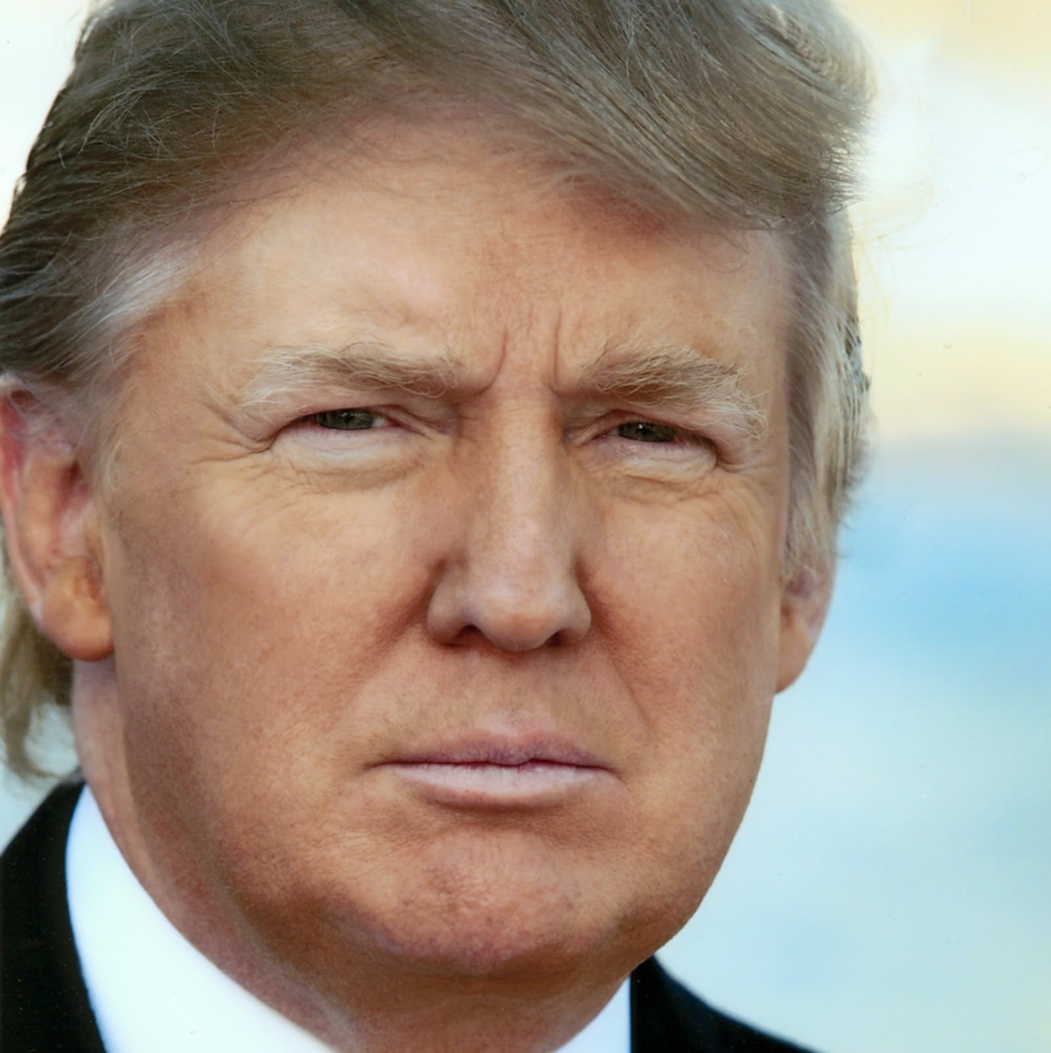
Donald Trump Approval: Key Groups
TRUMP
APPROVAL

Slide 9
Donald Trump Approval: By State
TRUMP
APPROVAL

Slide 10
Prefer US Senator Who Supports/Opposes Trump?
Overall, do you want a US Senator who is supportive of Donald Trump’s agenda or who opposes Donald Trump’s agenda?
49% Supportive
State | Supportive | Opposed
Arizona | 53% | 41%
Florida | 46% | 49%
Indiana | 56% | 35%
Louisiana | 49% | 43%
Missouri | 37% | 51%
Montana | 55% | 37%
North Dakota | 60% | 27%
Nevada | 52% | 40%
Ohio | 46% | 45%
Pennsylvania | 45% | 50%
West Virginia | 58% | 33%
43% Opposed

Slide 11
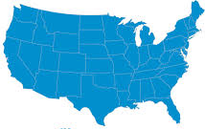
Most Important Issue
Which one of the following issues in the country is the most important to you?
Moderates (25%)
Independents (19%)
Healthcare
Jobs and the Economy
Taxes
Education
Gov’t Spending
Social Security and Medicare
Environment
Government dysfunction
Immigration
Income Inequality
Nat’l Security/ Terrorism

Slide 12
Obamacare Support
Focusing just on healthcare, do you support or oppose the Affordable Care Act, also known as Obamacare, that passed in 2010?
48% Support
47% Oppose

Slide 13
AHCA Support/Opposition
Based on what you’ve heard, do you support or oppose the new healthcare bill passed by the House of Representatives?
Obamacare
House Bill
48% Support
30% Support
47% Oppose
53% Oppose

Slide 14
Strong AHCA Supporters
VERY CONSERV. REPUBLICANS
35% are strong supporters
Strongly Support AHCA

Slide 15
Strong AHCA Opponents
LIBERAL
83% are strong opponents
DEMOCRAT
76%
AFRICAN AMERICAN
69%
Strongly Oppose AHCA
WOMEN / COLLEGE DEG.
58%
MODERATE
54%
WOMEN / $75K+
54%
INDEPENDENT / $75K+
53%
COLLEGE GRADUATE
52%
INDEPENDENT / 45+
50%

Slide 16
Undecided on AHCA
REPUBLICAN <45
41% are undecided
MODERATE REPUBLICANS
37%
UNDECIDED 2018 SENATE
29%
Don’t
Know
CONSERVATIVE INDEPENDENTS
27%
REPUBLICAN <$75K
26%
Income
<$30K
24%
HIGH SCHOOL OR LESS
24%

Slide 17
Information Flow
Has what you have seen, read, or heard recently about the new healthcare law passed by the House made you more favorable to the law, more opposed to the law, or has it not changed your opinion?

Slide 18
Impact of Bill on Personal Situation
If the new healthcare bill that passed the US House of Representatives becomes law, do you think you personally will be better off under that new health care law, worse off, or will your situation not change much?
Who Thinks Situation Will Not Change?
65+ (60%)
Arizona (59%)
Independents $75K+ (58%)
Undecided for Senate 2018 (60%)
Voted for “other” candidate in 2016 (59%)
West Virginia (58%)

Slide 19
Senate Action on AHCA
Now that the bill has passed the US House of Representatives, it heads to the US Senate. Do you believe the Senate should…

Slide 20
Top Priority of Healthcare Reform
In your opinion, what should be the top priority of healthcare reform?

Slide 21
Effective Messages
Obamacare has been a costly failure—leading to lost coverage and higher health care costs. It’s time for a system where families and doctors are in charge of healthcare decisions, not Washington politicians.
14%
58%
The bill offers a better way to cover individuals because it allows people to get the coverage they want, not the coverage the government forces them to buy.
58%
16%
The new bill gives each state the flexibility to set its own essential health benefits so that families can choose between different types of plans, according to their actual needs.
62%
20%
The new bill is the first step toward a patient-centered healthcare system that will provide Americans access to quality, affordable healthcare coverage, and allow families to choose the coverage that best meets their needs.
10%
59%

Slide 22
House Bill Key Provisions: Support or Opposition
I’m going to read you some different components of the healthcare bill that passed the House of Representatives.
Repeals most of Obamacare.
47%
48%
Repeals most of the new taxes created under Obamacare.
41%
47%
Defunds Planned Parenthood for one year.
55%
41%
Ends the mandate that people must have health insurance or pay a fine to the government.
52%
43%
Changes key parts of Obamacare.
43%
45%
22

Slide 23
House Bill Key Provisions: Support or Opposition
I’m going to read you some different components of the healthcare bill that passed the House of Representatives.
Gives states the ability to waive regulations created by Obamacare, including protections relating to patients having preexisting conditions.
53%
41%
Allows insurers to charge younger people less for insurance coverage than older people, because older people have higher health care costs.
56%
37%
Cuts funding for Medicaid by $880 billion dollars over 10 years.
64%
28%
Imposes a surcharge of 30% on those who allow a two-month gap in their health insurance coverage before they purchase insurance again.
24%
69%
Allows insurers to charge older people more for insurance coverage than younger people, because older people have higher health care costs.
75%
20%
23

Slide 24
Support For Key Provisions By Party: 1
Repeals most of Obamacare
Repeals most of the new taxes created under Obamacare
Defunds Planned Parenthood for one year
85%
77%
69%
48%
46%
47%
47%
41%
42%
10%
17%
27%
47%
48%
41%
39%
55%
54%
24

Slide 25
Support For Key Provisions By Party: 2
Ends the mandate that people must have health insurance or pay a fine
Changes key parts of Obamacare
Gives states the ability to waive regulations created by Obamacare
67%
65%
43%
51%
44%
45%
50%
41%
36%
21%
28%
52%
45%
43%
38%
51%
53%
55%
25

Slide 26
Support For Key Provisions By Party: 3
Allows insurers to charge younger people less
Cuts funding for Medicaid by $800 billion
Surcharge of 30% on those who allow a 2-month gap
Allows insurers to charge older people more
52%
53%
37%
37%
30%
31%
30%
28%
27%
24%
20%
26%
42%
38%
56%
56%
64%
59%
64%
61%
63%
69%
75%
70%
26

Slide 27
Reform Priorities: Tier 1
Next, I’m doing to read you what some people say they want to see in healthcare reform going forward.
Make sure that every family has a choice of doctors.
95%
Guarantee affordable coverage for those with pre-existing conditions.
95%
Give people more control over their own health care decisions.
95%
Make sure that your insurance plan will let you keep your doctor.
94%
Guarantee that no one who currently has insurance will lose it.
89%
27

Slide 28
Reform Priorities: Tier 2
Next, I’m doing to read you what some people say they want to see in healthcare reform going forward.
Making sure the 24 million people who received health care under Obamacare keep their coverage
85%
Make health care coverage more affordable, even if that means keeping some of Obamacare.
84%
Lower co-pays for people with insurance
81%
Lower premiums for those who currently get health insurance from their employers
80%
Taking the federal government out of health care decisions
78%
Lower premiums for those currently on Obamacare exchanges
72%
Repeal all of Obamacare
60%
28
28
28

Slide 29
Top Health Care Priorities
Republicans
Make sure that your insurance plan will let you keep your doctor (90%)
Make sure that every family has a choice of doctors (87%)
Make sure that your insurance plan will let you keep your doctor (90%)
Give people more control over their own healthcare decisions (90%)
Trump Voters
Give people more control over their own health care decisions (90%)
Independents
Give people more control over their own health care decisions (83%)
Make sure that every family has a choice of doctors (86%)
Make sure that every family has a choice of doctors (80%)
Guarantee affordable coverage for those with pre-existing conditions (76%)
29

Slide 30
What Should US Senate Do?
Based on all that you’ve heard, what do you think the US Senate should do at this point?

Slide 31
Views On Democrats’ Opposition
Do you support or oppose Democrats opposing all replacement plans offered in Congress?
In your opinion, what should Democrats who voted for Obamacare back in 2010 be doing now?
36% Support
58% Oppose

Slide 32
What Should Democrats Do?
In your opinion, what should Democrats who voted for Obamacare back in 2010 be doing now?

